Slide 1
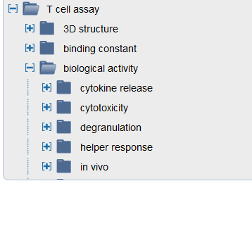
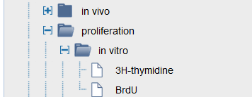
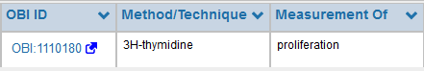
IEDB display of T cell epitope assays
OBI definition of epitope specific assay
label: 3H-thymidine assay measuring epitope specific proliferation of T cells
definition: A T cell epitope specific proliferation assay performed on cells in vitro that uses a tritiated thymidine incorporation assay.
logical definition: Equivalent to: 'in vitro assay measuring epitope specific proliferation of T cells‘ and ('has part' some 'tritiated thymidine incorporation assay')
OBI definition of general assay
label: tritiated thymidine incorporation assay
definition: A cell proliferation assay in which cells are cultured in the presence of tritiated thymidine which is incorporated into newly synthesized DNA of replicating cells (during the S phase of the cell cycle). The radioactivity of tritiated thymidine in a cell is a proxy for cells that were actively replicating.
logical definition: Subclass of: (cell proliferation assay) and (‘has part’ some ‘radioactivity detection’)
and ((realizes some ('molecular label role‘ and ('inheres in' some 'tritiated thymidine')))
and (has_specified_input some 'tritiated thymidine')

Slide 2
